Slide 1
Project Presentation of Industry Oriented Hands-on Experience (22CS422)
On
Automated Enumeration of Onion Links (Dark Web Crawler)
Nishant Dinesh R. (2210990617)
Geetansh Sood (2210990323)
Gautam Nagpal (2210990321)
Lovisha Bansal (2210990549)
Supervised By
Dr. PK Khosla Dr. Amanpreet Kaur Dr. Simarjit Kaur
Department of Computer Science and Engineering,
Chitkara University, Punjab

Slide 2
Introduction
The dark web is a hidden part of the internet accessible only through the Tor network, where websites use .onion domains for anonymous communication. Due to its anonymity, the dark web is often associated with cybercrime, illegal marketplaces, and hidden forums. This project develops an automated crawler to monitor and analyze dark web activities securely.
Key Points:
Accesses .onion websites anonymously using the Tor network
Uses DFS algorithm to discover and crawl onion links
Detects suspicious content using keyword analysis techniques
Captures screenshots and provides real-time monitoring dashboard
2

Slide 3
Problem Statement
Traditional search engines cannot access .onion websites on the dark web, making cybercrime monitoring and threat intelligence difficult. This project develops a Tor-based dark web crawler that automatically discovers onion links, analyzes suspicious content, captures screenshots, and provides real-time monitoring for cybersecurity research and OSINT operations.
Core Challenges:
Maintaining anonymous and secure access through the Tor network
Handling slow, unstable, and frequently changing .onion websites
Crawling JavaScript-heavy pages requiring browser automation
Accurately detecting suspicious content while reducing false positives

Slide 4
Objectives
The objective of this project is to develop a secure and automated dark web crawler capable of accessing .onion websites through the Tor network, collecting and analyzing suspicious content, and providing real-time monitoring for cybersecurity research, threat intelligence, and OSINT operations.
Key Objectives:
Enable anonymous access to .onion websites using the Tor network
Automatically discover and enumerate dark web links
Implement DFS-based crawling for systematic website exploration
Detect suspicious keywords and hidden threat-related content
Capture screenshots for evidence preservation and analysis
Store crawled data securely using databases
Provide a live dashboard for monitoring crawler activity and results

Slide 5
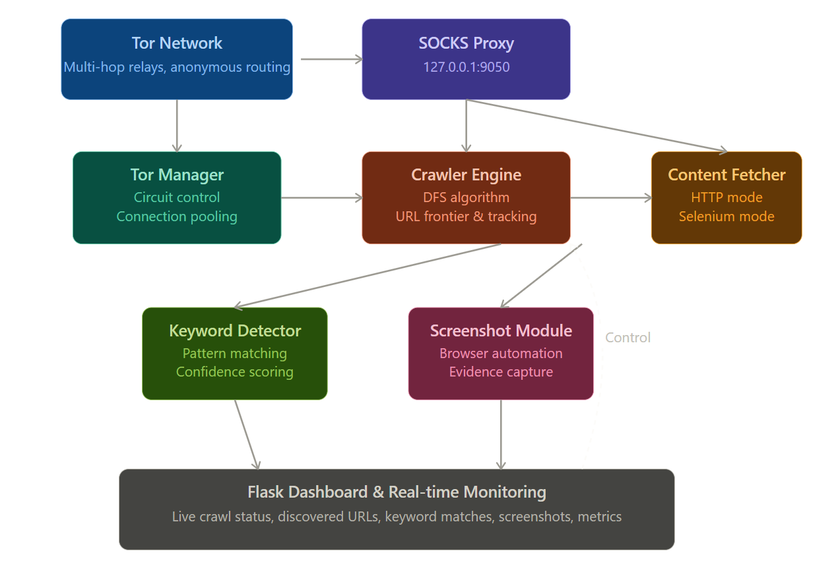
Architecture

Slide 6
Methodology
1. Tor Network Integration
The crawler connects to the Tor network using the Stem library and routes all requests through a SOCKS proxy. This ensures anonymous and secure communication while accessing .onion websites on the dark web.
2. DFS-Based Web Crawling
A Depth-First Search (DFS) algorithm is used to systematically explore onion websites. The crawler stores discovered URLs in a stack and continues crawling until the defined depth limit is reached.
3. Content Extraction and Parsing
The system retrieves webpage content using Requests and Selenium. HTML pages are parsed using BeautifulSoup and lxml to extract hyperlinks, metadata, and relevant textual information from websites.

Slide 7
Methodology
Filtering operations include:
Event selection based on event IDs and severity
Removal of duplicate or noisy logs
Log normalization and structured formatting
Secure forwarding of filtered telemetry
3. Mutual Exclusion with Sysmon Configuration
To further optimize telemetry reduction, a mutual exclusion mechanism is implemented by excluding telemetry events that are already monitored and captured by Sysmon according to its existing configuration file. This avoids duplication of monitoring data between ETW-based telemetry collection and Sysmon-generated logs. By eliminating overlapping events, the framework reduces redundant telemetry ingestion and improves overall efficiency in event processing and storage utilization.
4. Custom Python Detection Engine
The reduced telemetry is processed by a custom Python-based detection engine. This module applies custom detection logic to identify suspicious or malicious activities from the filtered events. The detection engine focuses on identifying actionable behaviors while avoiding unnecessary processing of irrelevant telemetry.

Slide 8
Methodology
4. Keyword Detection and Analysis
The crawler analyzes webpage content using exact and fuzzy keyword matching techniques. Suspicious terms related to cybercrime, hacking, drugs, or illegal activities are identified with confidence scores for better accuracy.
5. Screenshot Capture and Monitoring
When suspicious content is detected, Selenium captures screenshots of webpages for evidence preservation. A Flask-based dashboard displays live crawler activity, detected keywords, screenshots, and crawl statistics in real time.

Slide 9
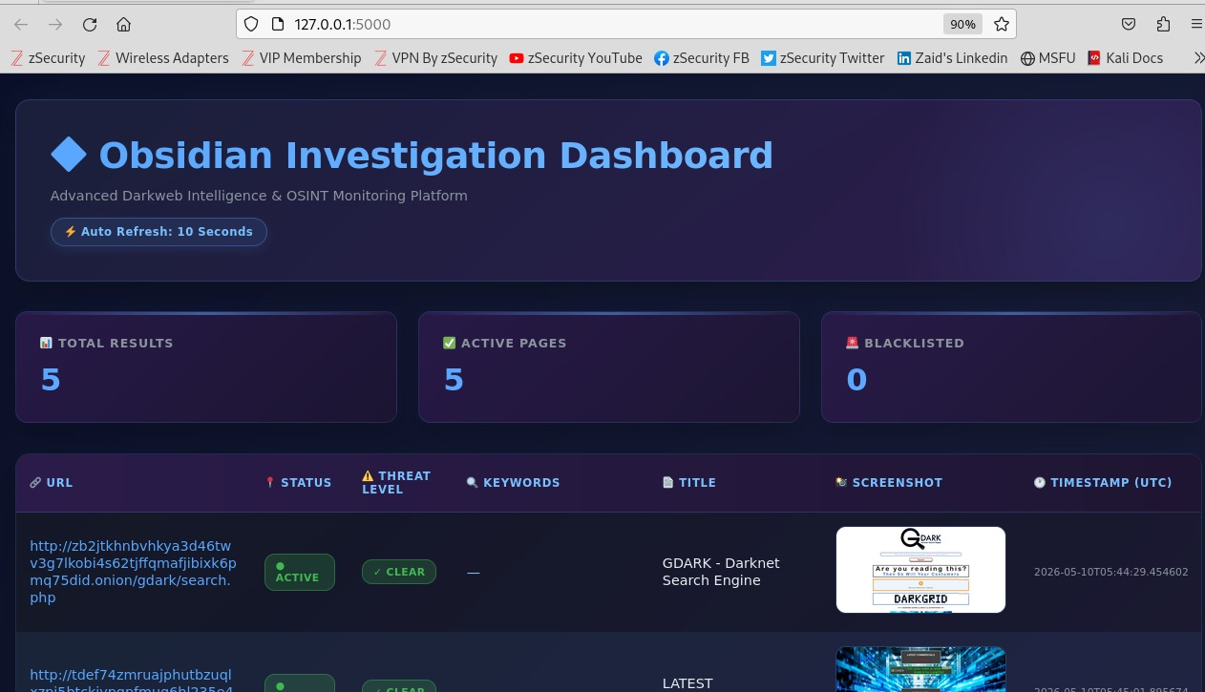
Working Screenshots
Dashboard Running:

Slide 10
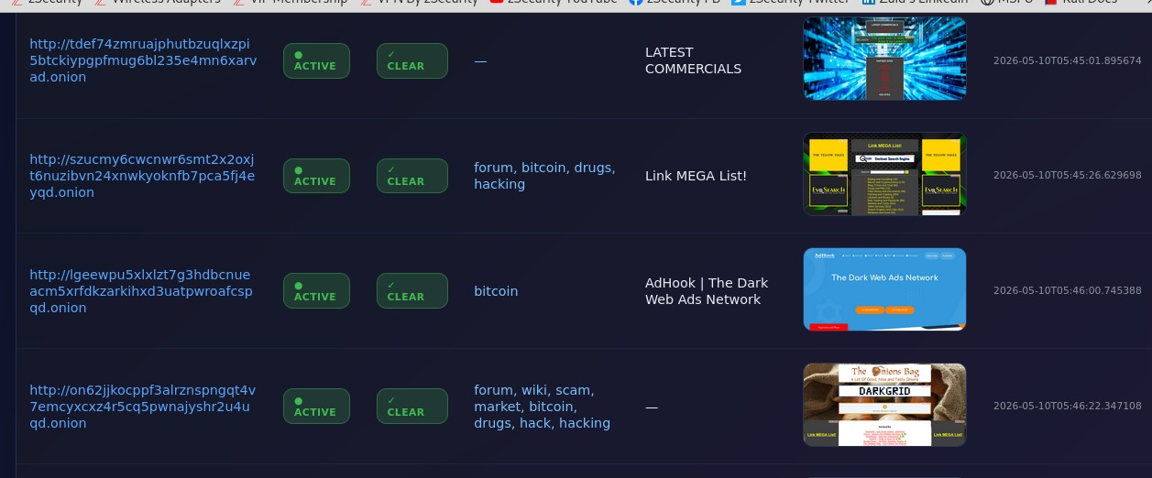
Working Screenshot
Dashboard Overview: Keywords Associated, Timestamp

Slide 11
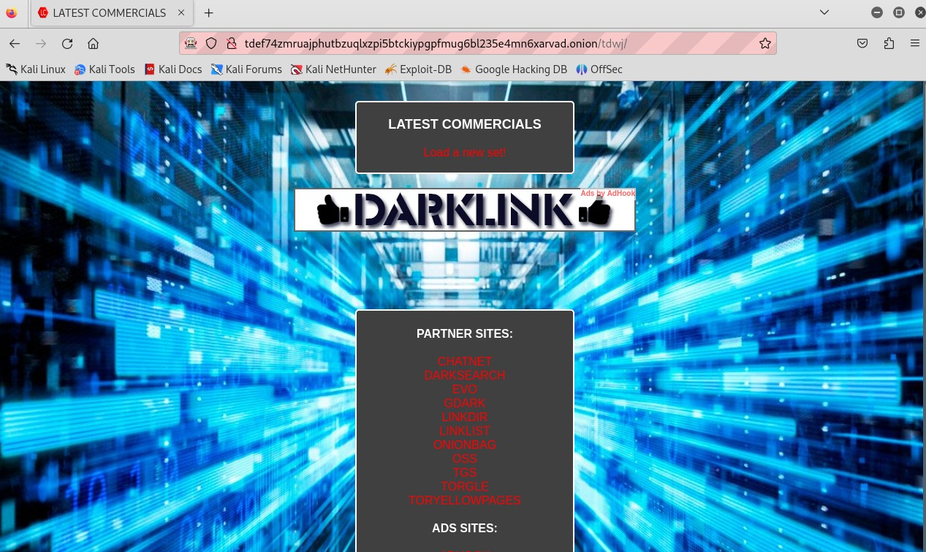
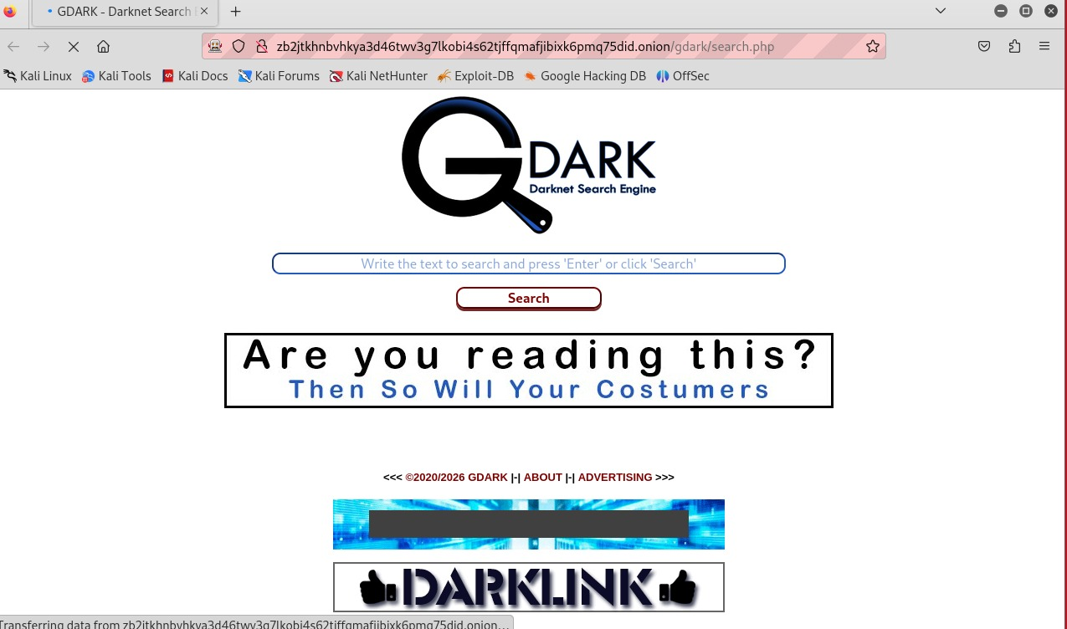
Working Screenshots
Screenshots Captured during real time : Onion Link directory and Gdark Search Engine

Slide 12
Future Scope
The project can be enhanced using Agentic AI and Large Language Models (LLMs) for intelligent threat analysis and automated decision-making. AI agents can autonomously classify dark web content, summarize suspicious activities, detect emerging cyber threats, and prioritize high-risk websites. LLMs can improve contextual understanding, multilingual analysis, and real-time reporting, making the crawler more adaptive, scalable, and efficient for advanced cybersecurity and threat intelligence operations.
GPT/Claude– Can analyze and summarize dark web content for faster threat intelligence reporting.
LangChain Agents – Enables autonomous AI agents to perform intelligent crawling, filtering, and decision-making tasks.
LLaMA (Meta AI) – Useful for offline and privacy-focused analysis of suspicious dark web data.
AutoGen (Microsoft) – Supports multi-agent collaboration for automated cyber threat detection and investigation workflows.

Slide 13
Conclusion
The Automated Onion Link Enumeration System successfully demonstrates secure and efficient dark web monitoring using the Tor network. The project enables automated crawling of .onion websites, suspicious keyword detection, screenshot capture, and real-time monitoring through a dashboard. It highlights the importance of cybersecurity tools for threat intelligence, OSINT gathering, and ethical dark web analysis.

Slide 14
Thank You
14

